Slide 1
Washington Township High School’s NJ-932nd AFJROTC Program
Back To School Night Presentation

Slide 2
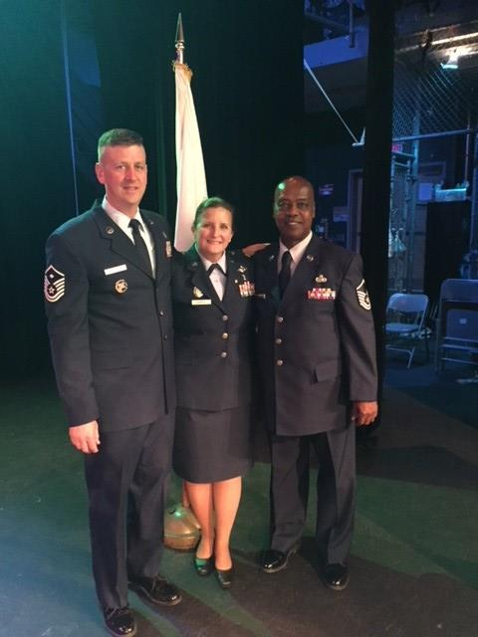
Instructors
All three of our Instructors here at the NJ-932nd are State certified “Teachers of Military Science” They are retired from the U.S. Air Force. Our instructors are available any time you have a question!
Lt. Col. Beth Ann Lumpkin, SASI (Senior Aerospace Science Instructor)
Contact Information: blumpkin@wtps.org / 856-589-8500, ext 7265
MSgt. Jeffrey Hood, ASI (Aerospace Science Instructor)
Contact Information: jhood@wtps.org / 856-589-8500, ext 7266
MSgt. Richard Harris, ASI (Aerospace Science Instructor)
Contact Information: rharris@wtps.org / 856-589-8500, ext. 7247

Slide 3
What is AFJROTC?
AFJROTC stands for Air Force Junior Reserve Officer Training Corps. This is a “life skills” course that teaches our cadets valuable life lessons, and teaches cadets to have pride and respect for our military, and for the all the veterans that are serving for us.
There is NO military commitment when you participate in this course.
AFJROTC is a 5 credit practical art course at Washington Township High School. One Practical Art course is required for graduation from high school in the State of New Jersey.

Slide 4
Curriculum
MONDAY:
Aerospace and Leadership lessons given by Instructors or Seniors
Possible Guest Speaker/Recruiter
Drill
TUESDAY:
Aerospace and Leadership lessons given by Instructors or Seniors
Possible Guest Speaker/Recruiter
Drill
WEDNESDAY:
Wellness ran by Cadets, ASI’s, or a Military guest
THURSDAY:
Uniform Inspection day
FRIDAY:
Flickerball, leadership lab, team building activities
*12-4(Senior) Cadets have LE400 as their curriculum

Slide 5
Wellness
WELLNESS WEDNESDAY: this is done every Wednesday to keep cadets active and ready for the Presidential Fitness Exam. Cadets will be expected to be in PT Gear every week once the PT Gear is distributed.
WHAT DO WE DO:
1 mile run
Push ups (as many as you can in 1 minute)
Sit ups (as many as you can in 1 minute)
Sit and reach
Team pushups
Different Fitness Games and Activities
Shuttle Run

Slide 6
The Uniform
Cadets must meet military grooming standards when in their uniform. The uniform must be worn during inspection days at all times.
We only wear the uniform once week
The uniform is worth 50% of their grade. If they don't wear the uniform then they CAN’T pass JROTC.
With our inspection behind us we will not by as tough as we were on cadets. However, that doesn’t not mean that we will not uphold standards. Standards will still be strictly enforced as we must make sure we teach so that cadets still live up to the standards set by HQ AFJROTC.

Slide 7
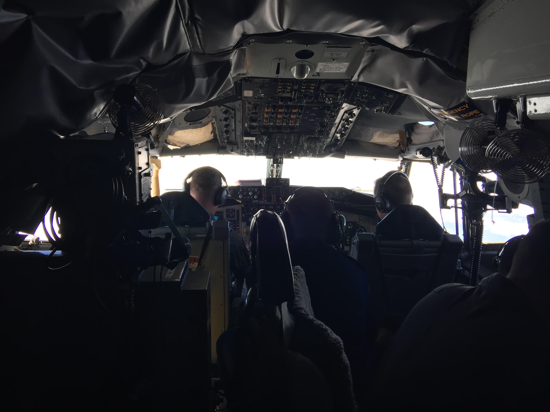
Field Trips & Opportunities
KC-135
Civil Air Patrol Flight & Museum Tour
Recruiting at the Middle Schools
Army Navy Game
Dover Air Force Museum
Battleship New Jersey
Girls State/Boys State
U.S. Coast Guard Training Center
Washington TWP Police Department

Slide 8
Cadet Leadership Course
This is a 6 day course used to teach students military life and leadership skills held at McGuire-Dix-Lakehurst Joint Base. Cadets earn a ribbon for this activity and must meet academic and physical requirements to participate.
Daily Routine:
PT at 0430-0530
Breakfast
Activity one till 1200
Chow
Activity two till 1800
Drill or activity
2100 showers
2130 in bed sleeping
Activities include:
Learning breaching tactics
Exploring marine helicopters
Touring the natural disaster training center
Laser tag
Swim lesson
The marine fitness test
Drill
Team bonding activities
Leadership seminars

Slide 9
Drill Team & Color Guard
Our Drill Team and Color Guard are open to all cadets in the corps to join!
Practices are held 2-3 times a week, and they go from September to April
Both teams earn J.V and Varsity letters at the end of the season.
The first practice was the 1st of October, and it will be held 2-3 days a week
The following dates are the drill competitions at which we will compete at this year:
Dieruff- 9 November
West Orange- 23 November
Sterling- 22 February
Bridgeton- 25 April
Glasgow- 1 Feb (probably not attend due to Military Ball)
Those interested in joining the Drill Team or the Colorguard should talk to the respective commanders, C/2nd Lt. Cayla Wade as Drill Team and C/2nd Lt. Isabella Santiago as Colorguard.

Slide 10
AFJROTC Functions
Dining Out (20 November): In the fall every year, we host a dining out at our school where all cadets and family members are invited to enjoy a nice evening of both food and fun.
Military Ball (31 January): In the winter, we host our military ball for all cadets and their choice of dates. This is a prom-type event that is done in a formal military ball manner. It is a great night with food, dancing, and fun!
Home Drill Competition (29 February): Yearly, our unit host a drill competition at our high school. It is a all hands on deck activity, that cadets earn at least 10 hours of service.
Final Awards (7 May): Every Spring, our unit hosts our final awards, where cadets who meet the requirements receive rewards for their hard work, parents and family are invited!
Military Hall of Honor: Every 2 years, our cadets and color guard assist with the Military Hall of Honor Induction ceremony, in which WTHS graduates who are Veterans, and current military members are inducted into the hall. Our Military Hall of Honor stretches out throughout D-Hall and it is maintained and kept up by our AFJROTC program.
Notes:
Add dates

Slide 11
Community Involvement &
Community Service
We are very heavily involved in the community and our school, and we help out with many service events a year
Our senior cadets are able to get scholarships their senior year if they complete at least 10 hours of service a year, which are provided by the Parent Booster Club.
Some of our most popular community service events include: M.S. Bike Ride, Home Drill Competition, Back to School Night, Project Graduation, Senior Award Ceremonies, Read Across America, Veterans Park Clean up, Veteran Day and Memorial Day Services, etc.
Project Graduation: Every year, our unit helps to assist the high school with their Project Graduation, this is a all hands on deck event, that counts as a spot promotion, it includes both a practice for the event, and then the actual night of the graduation ceremony.
Read Across America: Each year cadets chose to volunteer to read a book to the children in childcare, and to the kids at the Elementary Schools.
Back to School Nights: Each year the unit assists all Washington Twp. schools in their back to school night. Cadets will help direct parents to classes and answer questions.

Slide 12
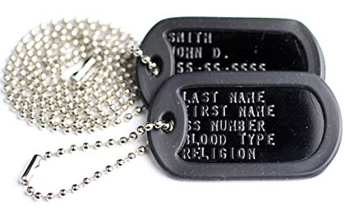
Fundraising Events
Veterans Park Clean-up- Every year we go to Veterans Park, next to the high school and behind WT Police Department, and clear up all the leaves and other debris. This leaves the park clean and presentable for the Veterans Day Ceremony. We earn $500 for this event and the sign up list for this event is 2 November (raindate 9 Nov).
Dog Tags and Challenge Coins- We are selling dog tags and NJ-932 challenge coins. We sell them for $10 each. If your cadet would like to buy either, or if you would like to buy either, please talk to a 12-IV or ASI to get the dog tag form or to get a coin for you. If there are any questions about either please talk to a 12-IV cadet or an ASI to help answer them.

Slide 13
Advancing In the Program
Promoting means increasing your rank in the Corps.
The higher your rank is, the more eligible you become for leadership opportunities.
You must get signatures from your teachers on your Promotion Recommendation Form (PRF) to promote in our program. Teachers must check yes or no regarding whether they feel you are good student for us to promote higher.
Leadership roles in our corps include being on Command Staff, and becoming a coordinator for certain events we hold.

Slide 14
Photos
Dennis Kelly Photos- Every year we will have individual pictures taken. Every cadet will have their picture taken and the entire Corps pictures will be displayed in the classroom by the door. These pictures are also available for purchase for personal use. These pictures will be taken on 17 October 2019.
Shots by Brian- This pictures is the entire NJ-932 AFJROTC Corps. It is the large picture hanging in the rear of the front classroom. Sibling/group photos available. These photos will be taken on 5 December 2019.

Slide 15
Social Media & Remind
TEXT: 08010
@nj932afj
*ran by SASI
Please follow our social media accounts and our Remind below! We encourage all cadets and parents to follow and sign up for the Remind because it is where we send out updates and helpful reminders for the cadets!

Slide 16
Questions & Closing Remarks
We hope this presentation gave you a good perspective of our program, and we hope you are as excited as we are to dive into a great school year!
If you have any questions or concerns, please ask us. We would be more than happy to answer your questions now or after the presentation!
Our Booster Club Representative would now like to say a few words. If you are interested in joining the Parent Booster Club, please make sure to grab a form on your way out!

